Slide 1
Ideological Scaling of Supreme Court Judges in India

Slide 2
Research Aim
The project aims to produce scaling estimates of ideological placement of judges in the supreme court between 2009 and 2020, utilizing the summary judgements written by the bench and assess whether there has been a shift in ideological diversity within the court post-2014.

Slide 3
Background
The Supreme Court consists of the Chief Justice of India and a maximum of fellow 33 judges
Judges sit in smaller benches of 2 or 3 known as a division bench and in larger benches of 5 or more known as a constitution bench when required to “settle fundamental questions of law and the constitution.”
The Chief Justice is nominated by the President of India. The President's role is primarily as a ceremonial head of state, distinct from the executive-centric role of the U.S. President which is more akin to the Prime Minister of India.
The Indian President is elected by the parliamentary chambers, generally representing the majority party's choice.
It's a common view that the President's tenure is influenced by the Prime Minister and the ruling party’s , as political favor for their selection.

Slide 4
Background
Since 2014, the conservative BJP party, led by Prime Minister Narendra Modi, has held significant power, with policies favoring Hindu majoritarianism.
There are concerns that the Supreme Court’s independence is being compromised, with claims that nominations of Supreme Court Judges are increasingly aligned with the BJP’s ideology, reducing the court’s ideological diversity
Nonetheless, the Court is historically perceived as highly objective.
For e.g. The court ruled against the building of Hindu temple by demolishing a medieval mosque, despite the construction of the temple being the most prominent campaigning point of the BJP since 1998, gaining significant traction among conservatives, similar to Trump's "build the wall" slogan.

Slide 5
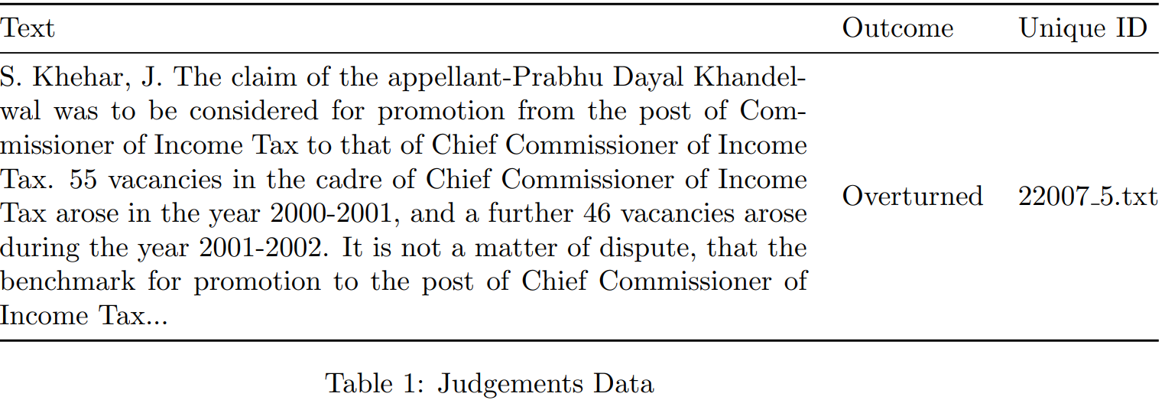
Data
Indian Legal Documents corpus (Malik et al., 2021) : Available with permission from Authors
Contains judgement summaries for 35000 cases heard by the supreme court between 1958 and 2020

Slide 6
Analytic Set
Cases include topics across crime, private disputes, business disputes, government disputes, constitutional amendments etc.
Cases where the Government is not the plaintiff or defendant are least likely to have ideological argumentation.
Before attempting scaling, we need to subset the data to Govermental cases.
Since we do not have this information, we do identify such cases through topic modelling

Slide 7
Topic Modelling
Methods:
1) Structural Topic Modelling
2) BERT topic Modelling
3) Zero-shot topic modelling with Chat-GPT

Slide 8
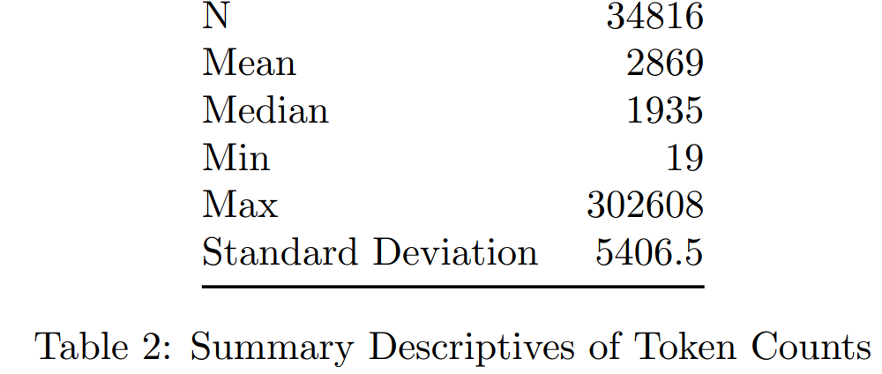
Topic Modelling
Methods:
1) Structural Topic Modelling
Input Data Processing:
- Remove names of authoring justice
- Remove Punctuation, Stopwords, top 10% most common and 5% least common words
- Remove tokens of length < 2 , digits, alphanumeric tokens

Slide 9
Topic Modelling
Methods:
1) Structural Topic Modelling :
- Results not helpful : Document length and complexity + complexity of specific type of topic needed
2) BERT topic modelling (Grootendorst, Maarten 2022)

Slide 10
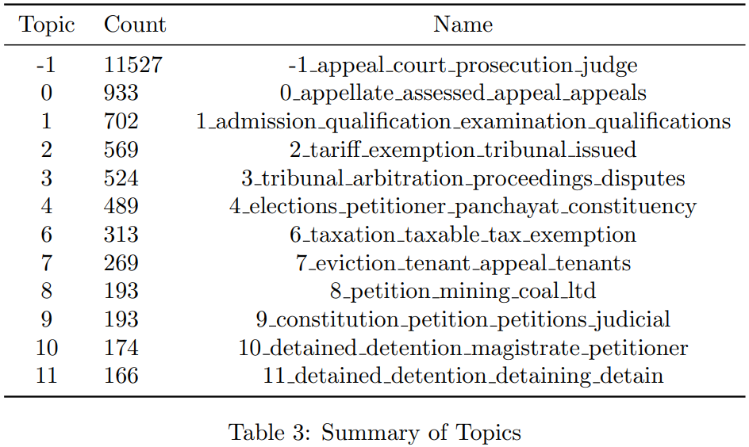
Topic Modelling
Methods:
1) Structural Topic Modelling :
2) BERT topic modelling (Grootendorst, Maarten 2022)
- Remove names of authoring justice.
- No other input processing as per author’s recommendation.
- Results: 198 Topics

Slide 11
Topic Modelling
Methods:
1) Structural Topic Modelling :
2) BERT topic modelling (Grootendorst, Maarten 2022)
- Not the best: Constitutional Cases are correctly identified, however
‘governmental’ cases are not easily identifiable. 11,000+ cases remain unidentified. Issues in general with accuracy

Slide 12
Topic Modelling
Methods:
1) Structural Topic Modelling :
2) BERT topic modelling (Grootendorst, Maarten 2022)
3) Zero-shot topic modelling with Chat-GPT
- Model: GPT-4-Turbo
- Input: First 4000 characters of each judgement
Prompt:
In this legal text determine if a government agency or constitutionally is involved as either plaintiff or defendant.
If the government is involved, return the response in the following format:
(government role):(specific government agency):(broad issue topic).
If government is not involved, format your response as:
Other: (plaintiff/defendant): broad issue.

Slide 13
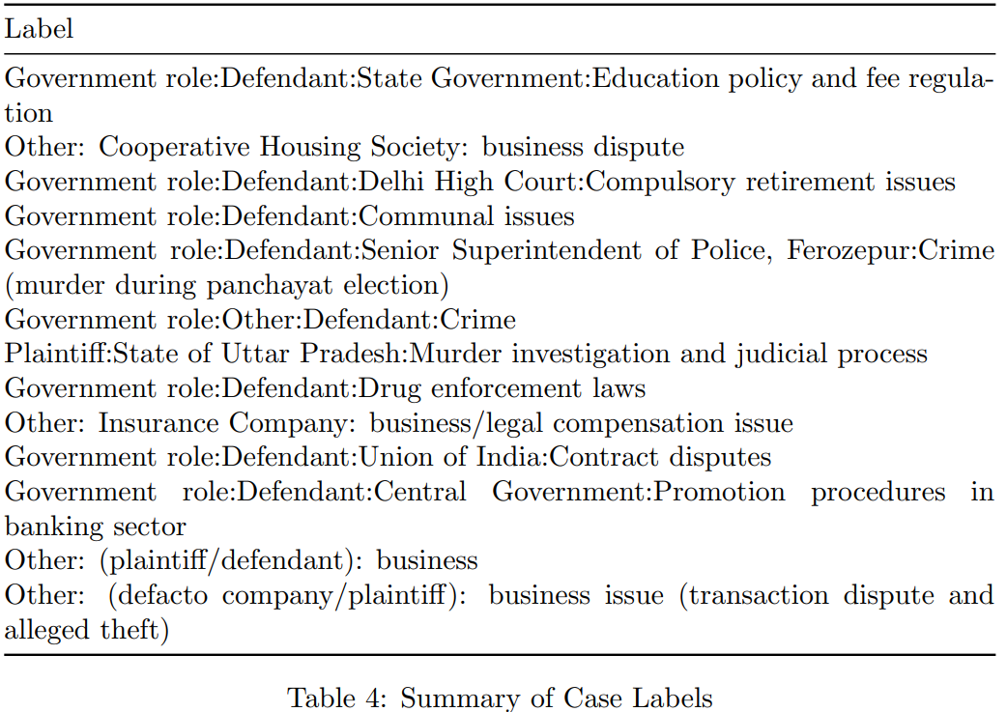
Topic Modelling
Methods:
1) Structural Topic Modelling :
2) BERT topic modelling (Grootendorst, Maarten 2022)
3) Zero-shot topic modelling with Chat-GPT

Slide 14
Topic Modelling
Methods:
1) Structural Topic Modelling :
2) BERT topic modelling (Grootendorst, Maarten 2022)
3) Zero-shot topic modelling with Chat-GPT:
- Highly accurate
- Output may not follow the exact format I prompted however, structured enough to easily differentiate between governmental and non governmental cases
- Hallucination in only 3 of 3200 cases
- Limited to sample of 3200 cases due to cost
- 2900 Governmental cases identified

Slide 15
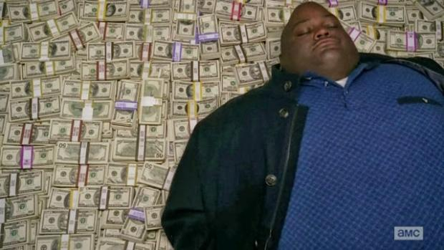
Topic Modelling
Methods:
1) Structural Topic Modelling :
2) BERT topic modelling (Grootendorst, Maarten 2022)
3) Zero-shot topic modelling with Chat-GPT:
- Highly accurate
- Output may not follow the exact format I prompted however, structured enough to easily differentiate between governmental and non governmental cases
- Hallucination in only 3 of 2900 cases
- Limited to sample of 2900 cases due to cost
PSA: Make sure your payment method is not on auto charge
Sam Altman with my $50

Slide 16
Scaling

